Slide 1
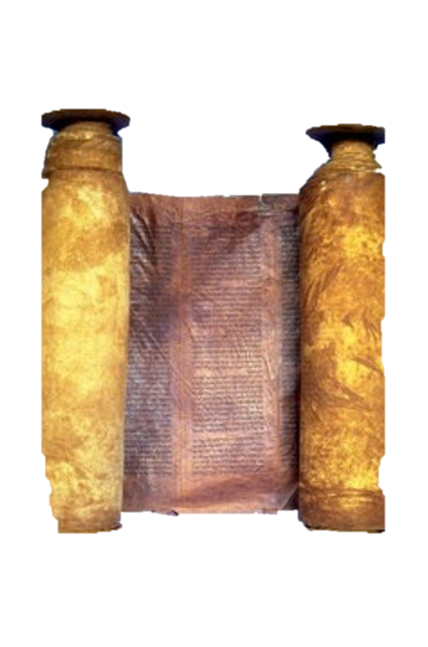
A free CD of this message will be available immediately following the service
1 Kings
19-20
A podcast will also be available later this week at calvaryokc.com

Slide 2
lxx ~ “as sure as I'm Jezebel and you're Elijah”
1 kings 19-20

Slide 3
1 kings 19-20

Slide 4
Life ~ nepesh - soul
1 kings 19-20

Slide 5
Mt. Carmel
104 miles
Beersheba
1 kings 19-20

Slide 6
1 kings 19-20

Slide 7
2 Cor. 1:8 ~ For we do not want you to be ignorant, brethren, of our trouble which came to us in Asia: that we were burdened beyond measure, above strength, so that we despaired even of life.
1 kings 19-20

Slide 8
Matt. 26:37-38 ~ ³⁷ And He took with Him Peter and the two sons of Zebedee, and He began to be sorrowful and deeply distressed. ³⁸ Then He said to them, “My soul is exceedingly sorrowful, even to death. Stay here and watch with Me.”
1 kings 19-20

Slide 9
1 kings 19-20

Slide 10
Mt. Carmel
Beersheba
Mt. Horeb?
Mt. Horeb?
1 kings 19-20

Slide 11
Cave ~ literally, the cave (Ex. 33)
1 kings 19-20

Slide 12
1 kings 19-20

Slide 13
Still small voice ~ literally, a voice of gentle silence
1 kings 19-20

Slide 14
1 kings 19-20

Slide 15
Luke. 4:13 ~ Now when the devil had ended every temptation, he departed from Him until an opportune time.
1 kings 19-20

Slide 16
1 kings 19-20

